Slide 1
Angular 2 – Routing and Forms

Slide 2
Session Objective
To understand and workout the base concept of routing and Navigation using dynamic forms from below topics.
Routing
Navigation
Form

Slide 3
Routing
Routing used to navigate to different pages based on the option they selected from a page.
The required Angular component will be rendered on selected option.

Slide 4
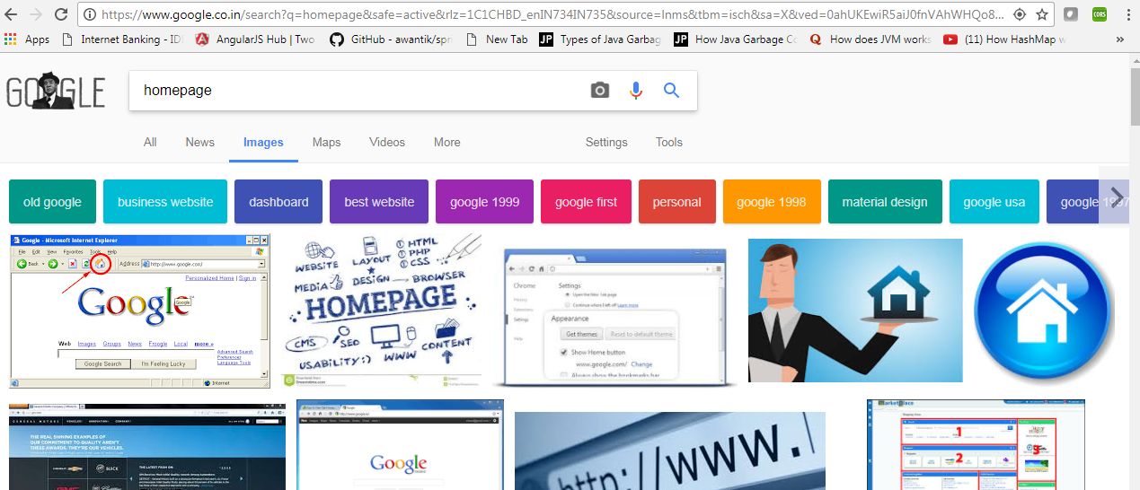
Routing

Slide 5
Router
There are three main components that we use to configure routing in Angular:
Routes
RouterOutlet
RouterLink

Slide 6
Router Demo
Step 1:
Add the router link in template in app.component.ts
import { Component } from '@angular/core';
@Component({
selector: 'my-app',
template: `
<ul>
<li><a [routerLink] = "['/Product']">Product</a></li>
<li><a [routerLink] = "['/Inventory']">Inventory</a></li>
</ul>
<router-outlet></router-outlet>`
})
export class AppComponent { }
template: `
<ul>
<li><a [routerLink] = "['/Product']">Product</a></li>
<li><a [routerLink] = "['/Inventory']">Inventory</a></li>
</ul>
<router-outlet></router-outlet>`
})

Slide 7
Router Demo – step 2
import { NgModule } from '@angular/core'
import { BrowserModule } from '@angular/platform-browser';
import { AppComponent } from './app.component';
import { Appproduct } from './product.component'
import { AppInventory } from './Inventory.component'
import { PageNotFoundComponent } from './NotFound.component'
import { RouterModule, Routes } from '@angular/router'
const appRoutes: Routes = [
{ path: 'Product', component: Appproduct },
{ path: 'Inventory', component: AppInventory },
{ path: '**', component: PageNotFoundComponent }
];
@NgModule ({
imports: [ BrowserModule,
RouterModule.forRoot(appRoutes)],
declarations: [ AppComponent,Appproduct,AppInventory,PageNotFoundComponent],
bootstrap: [ AppComponent ]
})
export class AppModule { }
import { RouterModule, Routes } from '@angular/router‘ )],
const appRoutes: Routes = [
{ path: 'Product', component: Appproduct },
{ path: 'Inventory', component: AppInventory },
{ path: '**', component: PageNotFoundComponent }
];
RouterModule.forRoot(appRoutes)],

Slide 8
Routes
Routes is an object that we use on our application component that describes the routes we want to use. For instance, we could write our routes like this
path used to specify the URL
Specify the component want to route to
pathMatch using the redirectTo option
const routes: Routes = [
{ path: “ '', redirectTo: 'home', pathMatch: 'full' },
{ path: 'home', component: HomeComponent },
{ path: 'login', component: LoginComponent },
{ path: 'dashboard', component: DashboardComponent }
];

Slide 9
Routing
RouterModule.forRoot() function used to imports NgModule:
imports: [
RouterModule.forRoot(routes)
],
import statement “import router components and services”

Slide 10
RouterOutlet
template: `
<ul>
<li><a [routerLink] = "['/Product']">Product</a></li>
<li><a [routerLink] = "['/Inventory']">Inventory</a></li>
</ul>
<router-outlet></router-outlet>`
})
export class AppComponent { }

Slide 11
RouterOutlet
The RouterOutlet directive inform the router place to render the content in the view. Whenever we switch routes, our content will be rendered in place of the router-outlet tag.
@View({
template: `
<div>
Stuff in the outer template here
<router-outlet></router-outlet>
</div>
`
})

Slide 12
RouterLink
Router Link directive helps to Navigate between routes
The argument to router-link is an array with the route name as the first element (e.g. ['home'])
<li><a [router-link]="['home']">Home</a></li>
<li><a [router-link]="['login']">Login</a></li>
<li><a [routerlink]="['dashboard']">Dashboard</a>
</li>

Slide 13
Router Demo – step 3
Inventory.component.ts

Slide 14
Router Demo – step 4
Product.component.ts

Slide 15
Sample Demo

Slide 16
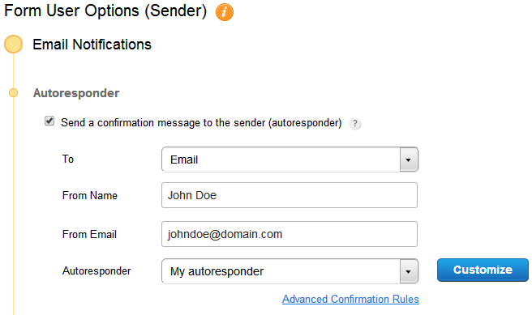
Form
A form is a document with fields to write or select, for a series of documents with similar contents.

Slide 17
Model Class
export class Student {
constructor(
public rollNo: number,
public name: string,
public course: string,
public branch?: string
) { }
}
Model class with
constructor and attributes

Slide 18
WebPage
<label for="rollNo">Roll No</label>
Syntax Creating Label:
< input type="text“
class="formcontrol“
id="rollNo“ required [(ngModel)]="model.rollNo"
name="rollNo"
#rollNo="ngModel“ >
Syntax Creating text box:

Slide 19
Select Option
ngFor=“let p of courses”
courses we are getting from previous page and p is a local variable in for loop
<select class="form-control“
required [(ngModel)]=
"model.course“ name="course">
<option *ngFor="let p of courses" [value]="p">{{p}}</option>
</select>

Slide 20
Select Option
Select one from multiple option syntax for Angular
courses = ['Select the course','Computer', 'Electronics',
'Mechanical', 'Electrical','Chemical'];

Slide 21
Submit Button
<button type="submit" class="btn btn-danger">Submit</button>
Angular Syntax for submit button

Slide 22
Steps to create a form
Step 1 : Create Student.ts file
Step 2 : Create Student-form.component.html file
Step 3 :Create Student-form.component.ts file

Slide 23
Complete form with supporting classes

Slide 24
Form component demo

Slide 25
Recollect
Routing : Routing helps users to navigate to different pages
Form :A form is a document with fields to write or select, for a series of documents with similar contents.

